Slide 1


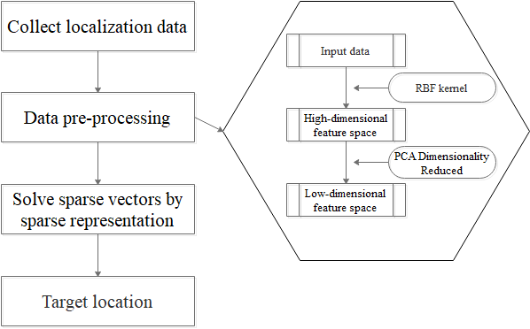
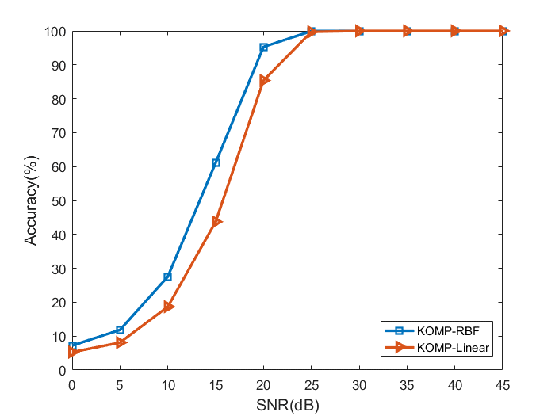
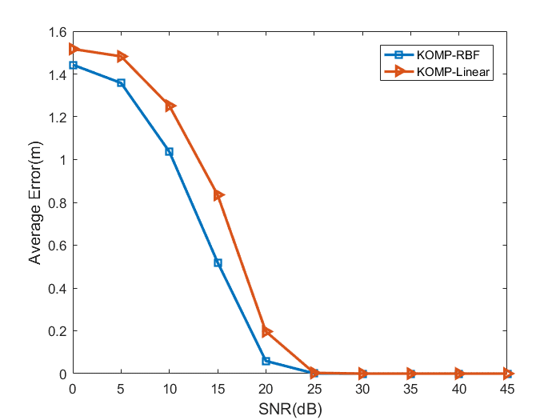
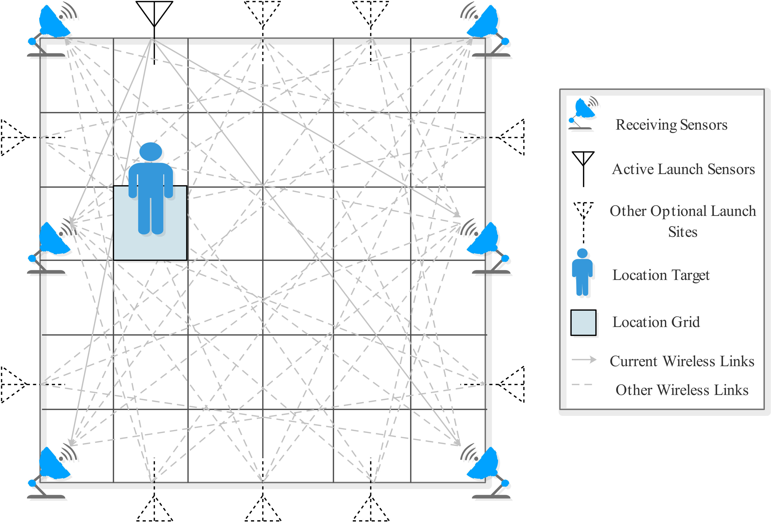
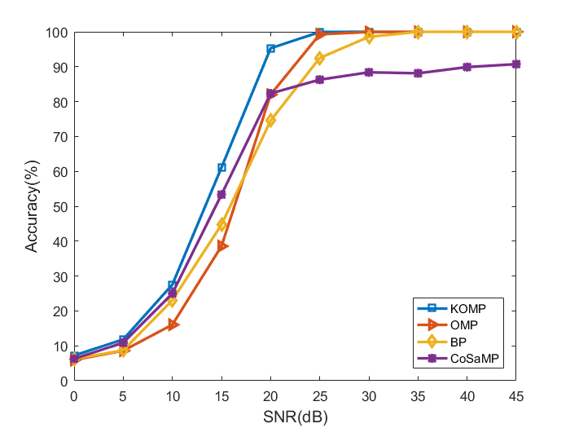
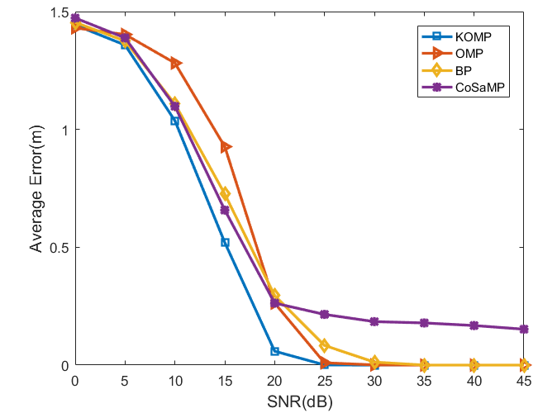
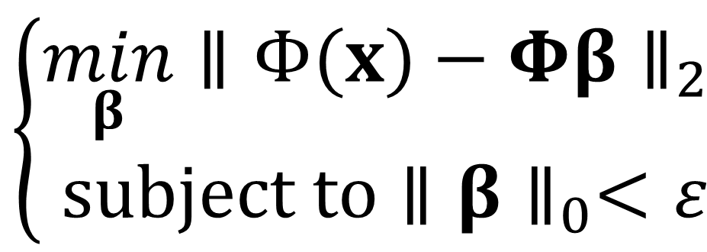
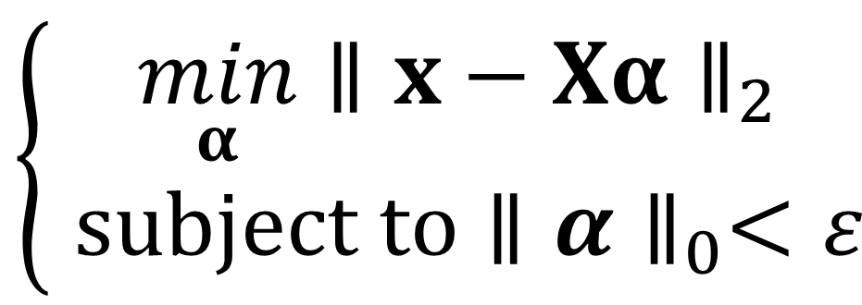
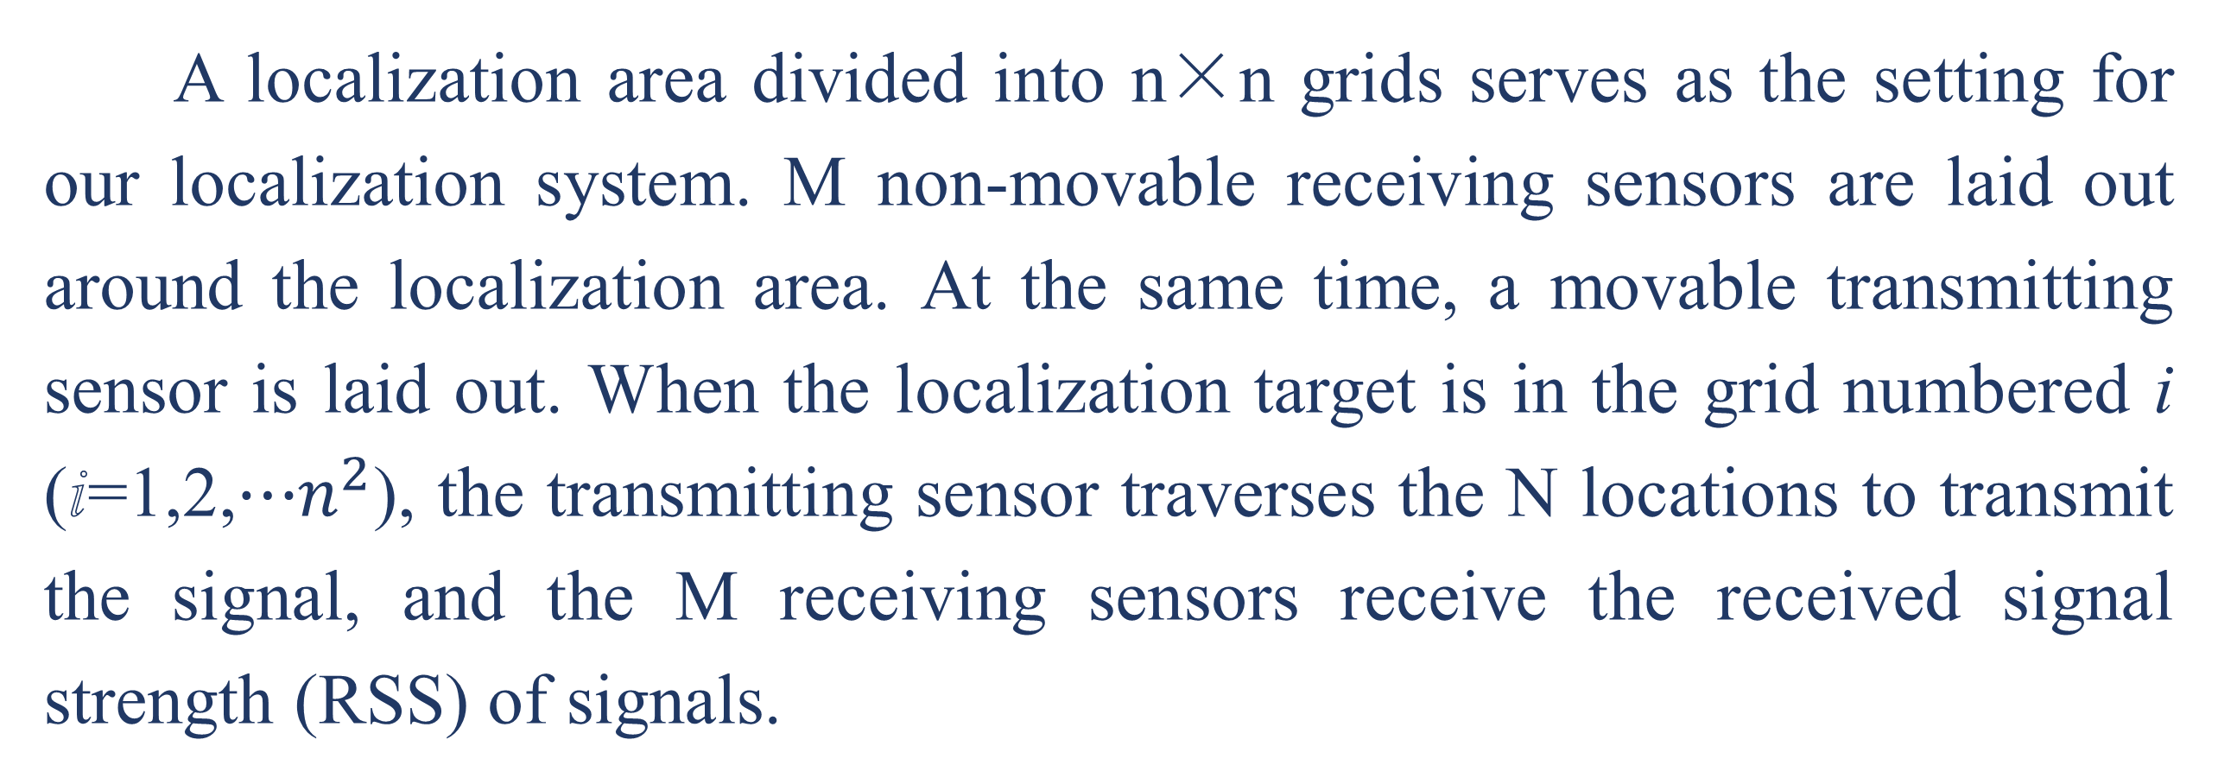
Device-Free Indoor Localization Based on Kernel Sparse Representation
Yuqi Jiang¹, Benying Tan¹, Shuxue Ding^{1 ,*}, Yujie Li¹, Xiaoju Chen¹
¹School of Artificial Intelligence, Guilin University of Electronic Technology, Guilin, China 541000
*Email: sding@guet.edu.cn
INTRODUCTION
Data Processing Stage:
Device-free localization (DFL) is now a much-needed direction in localization technology. In this study, we consider localization as a classification problem using sparse representation, which speeds up localization and makes real-time localization possible. We introduce the kernel sparse representation (KSR) method, i.e., the kernel function is combined with the sparse representation. First, the data is kernel transformed and projected to a reduced dimension, making the computational less difficult. Then, in order to obtain the sparse vectors, we apply orthogonal matching pursuit (OMP). According to the experiment results, KOMP, which has good noise immunity compared to OMP and other sparse coding algorithms.
$$\left\{\begin{matrix}\min_{α}∥x−Xα∥_{2} \\ \text{subject} \text{to}∥α∥_{0}<ε\end{matrix}\right.$$
kernel transformation
$$\left\{\begin{matrix}\min_{β}∥Φ(x)−Φβ∥_{2} \\ \text{subject} \text{to}∥β∥_{0}<ε\end{matrix}\right.$$
Target equation conversion
We regard DFL as a classification problem. Our proposed model is based on kernel sparse representation, which combines kernel function with sparse representation. The kernel sparse representation can be obtained by generalizing the sparse representation.
Then we use KOMP which we proposed to solve the equation after kernel transformation. We can obtain the sparse vector to achieve localization.
EXPERIMENTAL RESULTS
Actual experimental data collected for device-free localization
We arranged six sensor receiving nodes and one sensor transmitting node around a 3m×3m experimental scenario. Each grid in this localization region is 0.5 m×0.5 m and has a size of 6×6. When the localization target is in it, the transmitting node transmits radio waves, and the receiving node receives them.
Fig. 1. Overall device-free localization process
MODEL AND FORMULATION
Fig. 3. Localization performance of our proposed KOMP based on the RBF kernel and the linear kernel respectively in different noise environments. On the left: The proposed KOMP localization accuracy based on the RBF kernel and the linear kernel. On the right: Average error (AE) of localization for different kernel functions.
Data Collection Stage
Fig. 4. Localization performance of the proposed KOMP and the compared algorithms in different noise environments, i.e., different SNR. On the left: Localization accuracy of KOMP and other compared algorithms. On the right: Average error (AE) of localization for different algorithms.
Fig. 2. Scene model for device-free localization
As shown in Fig. 4 and Fig. 5, all experiments can verify the effectiveness of KOMP. The nonlinear algorithm KOMP has noise resistance and higher accuracy. KOMP also performs better on the average error of localization.
A localization area divided into n×n grids serves as the setting for our localization system. M non-movable receiving sensors are laid out around the localization area. At the same time, a movable transmitting sensor is laid out. When the localization target is in the grid numbered i (ⅈ=1,2,⋯$n^{2}$), the transmitting sensor traverses the N locations to transmit the signal, and the M receiving sensors receive the received signal strength (RSS) of signals.
CONCLUSION
We have proposed a device-free localization algorithm KOMP based on kernel sparse coding, which achieve more accurate localization. KOMP uses the kernel function to increase the degree of data separability which also improve the localization performance. Experimental results demonstrate the outperformance of our proposed algorithm.

