Slide 1

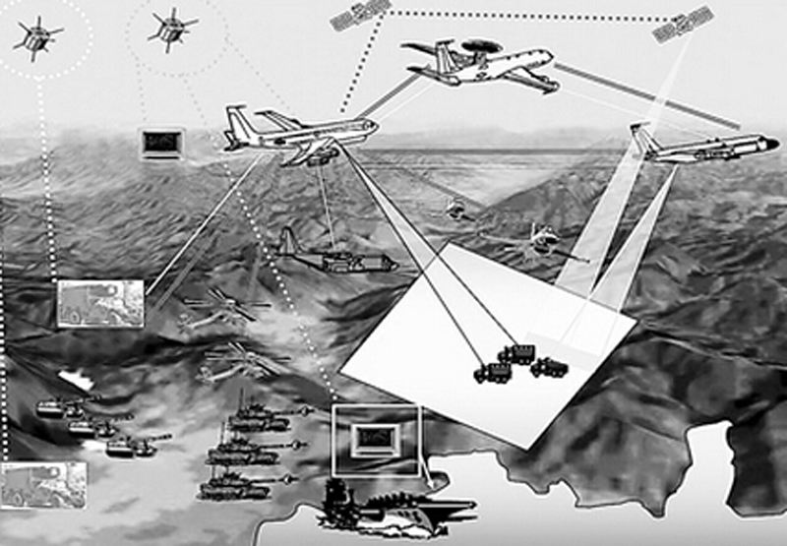
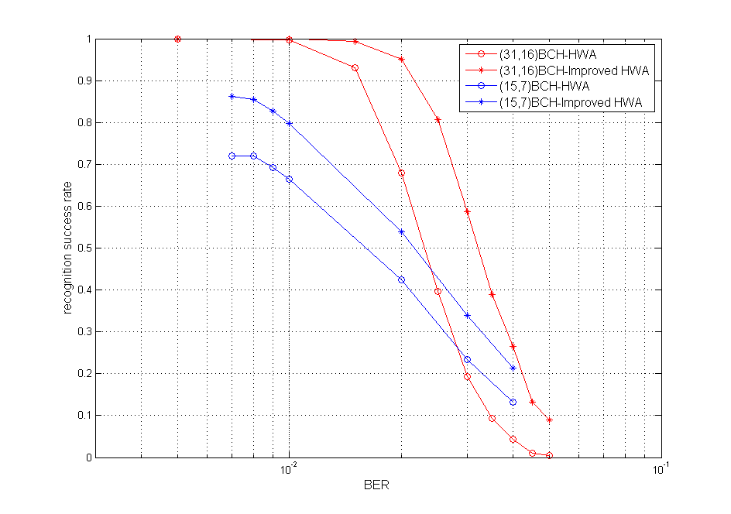
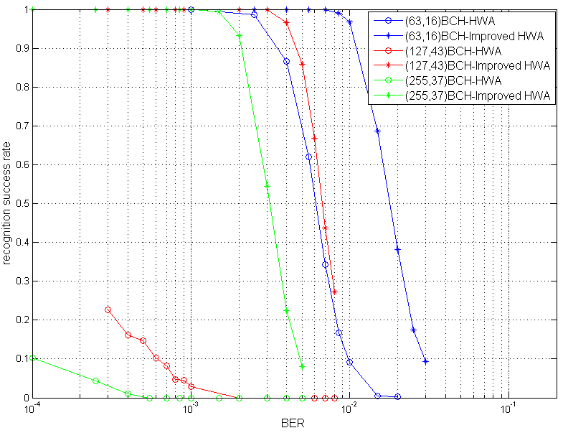
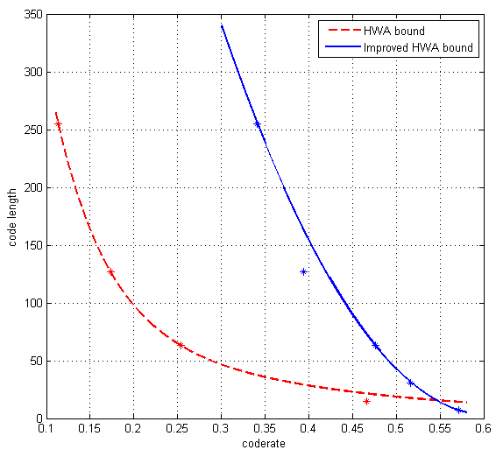
An Improved HWA Algorithm for Blind Recognition of Linear Block Codes
Di Mao^{1,2} *, Fuqiang Li¹
¹China Electronics Technology Group Corporation(CETC),
20th Institute Key Laboratory of Technology on Datalink, Xi’an, China
²State Key Laboratory of ISN Xidian University, Xi’an, China
*E-mail: mdcom1@126.com
Introduction
Blind channel coding identification refers to the technology that the receiver obtains the coding parameters of the transmitted signal through blind identification algorithm analysis when the coding parameters of the received signal are unknown or partially unknown.
Applications:
intelligent communication
communication reconnaissance and network countermeasure
Hamming-Weight-Analysis (HWA) algorithm enjoys the benefits of simple and fast, and it can be widely used in coding recognition.
Problems: Classic algorithm have defects
When identifying a block code with a long code length
When identifying block codes with a coderate close to 0.5
Sliding-Window Filtering HWA Algorithm
In order to overcome the shortcomings of classic algorithms, we proposes an improved HWA algorithm based on sliding-window filtering method.
The reason for the phenomenon in this figure is that with the increase of code length, the capacity of codebook is also increasing significantly. With the increase of codebook capacity, the specificity of codeword weight distribution and uniform distribution in codebook will gradually weaken.
The key steps of sliding-window filtering HWA algorithm: Assuming that the filtering threshold is and the filtering coefficient is , The sliding window filtering method is used to get the filtered distribution distance by successively passing the code weight distribution distance pattern through the window. In the filtered weight distribution distance pattern, take the maximum value of weight distribution distance, and is the real code length estimation to complete the blind recognition.
Testing Process
Step 1: Rule Formalization. Translating the original rules to the formalized description language.
Step 2: Rule Analysis. Extracting the I/O state variables for single rule and determining the relation among rules by identifying shared I/O state variables.
Step 3: Test Sequence & Test Case Generation. Selection and formation of test sequences and generation of test cases from test sequences.
Step 4: Conformance Testing. Generation and implementation of DEVS test models on test driver and SUT.
Fig. Flow chart of sliding-window filtering HWA Algorithm
Fig. Estimated codeword weight distribution(red circle:wrong peak, green circle: right peak)
Simulation results and Analysis
Fig. Performance comparison between sliding-window filtering HWA algorithm and classical algorithm
$$CONCLUSION$$
Fig. Performance bound improvement of
sliding-window filtering HWA
The sliding-window filtering HWA recognition algorithm effectively overcomes the defects of the classical HWA algorithm. It also expand the application range of communication blind recognition system and improve the accuracy of recognition results.

