Slide 1


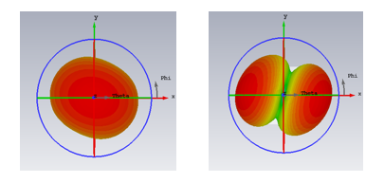
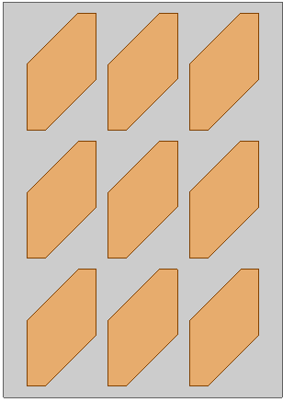
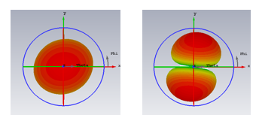
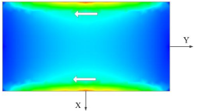
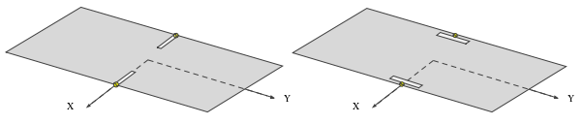
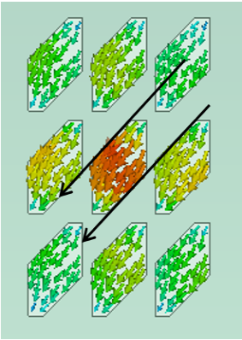
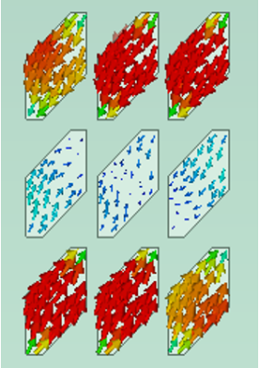
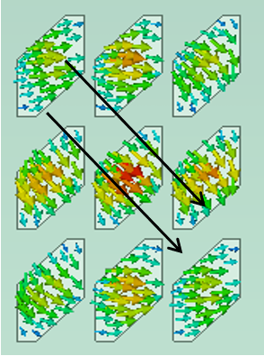
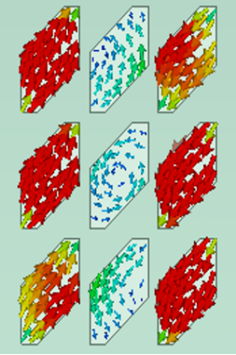
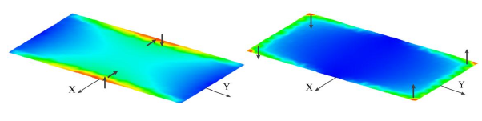
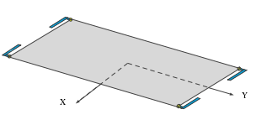
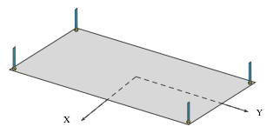
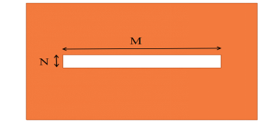
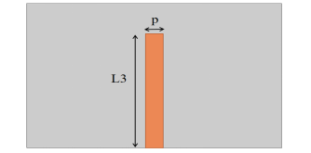
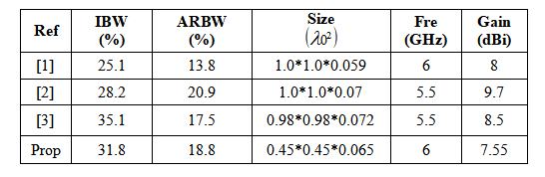
A Low-Profile Broadband Circularly Polarized Metasurface Antenna Using CMA
Qi Xia¹, G. S. Cheng^{1,2}
1Information Materials and Intelligent Sensing Laboratory of Anhui Province, Anhui University, Hefei, 230601, China.
2Anhui Province Key Laboratory of Target Recognition and Feature Extraction, Lu’an, China, 237010.
Introduction
Circularly polarized (CP) antennas are widely used in wireless communication systems because of its good electromagnetic characteristics. CP antennas have the advantage of reducing polarization mismatch and avoiding multipath interference and distortion. Although the traditional CP microstrip antennas have the advantage of simple structure and easy manufacturing. But they have the disadvantage of relatively narrow bandwidth. The MTS has been studied extensively in recent years. It has been widely used in CP patch antenna which can effectively improve the impedance bandwidth and axial ratio bandwidth of the antenna , and the metasurface has the characteristics of low plane surface, which can effectively reduce the size of antenna. The theory of characteristic mode (TCM) is an effective analysis tool, through which the mode of antenna, corresponding currents and far-field radiation patterns are analyzed, which enables us to have a clear understanding of the working principle of antenna and is of great significance to guide the design of antenna.
Characteristic Mode analysis
Characteristic Mode analysis
Fig shows the MS values of the first four modes for a 34mm*24mm MTS..
(a)
(b)
(c)
(d)
Characteristic Mode analysis
It can be seen from Figure that the CA difference between mode 1 and mode 3 at 7.3ghz reaches 70 degrees, and their MS values are close to each other. These two modes are alternative modes.
There are two kinds of feed methods in Characteritic Mode Theory, namely inductively coupled feed (ICE) and capacitance-coupled feed (CCE).
Characteristic Mode analysis
(a)
(b)
(c)
(d)
Simulation Results
Characteristic currents distribution of the four modes. (a) modes 1, (b) mode 2, (c) mode 3, (d) mode 4
Feeding structure
Compared with [1] and [2], this design has better AR and impedance bandwidth than [1]. It is similar to [2] in performance, but the design has a smaller volume and simpler structure. In the design of [3], it has a better AR axis ratio, but its structure is relatively more complex.
(a)
(b)
Fig. shows the gain variation of the antenna with frequency. The antenna has a peak gain of 7.55 dBi at 6.75 GHz.
(a) S11 (b) AR of the proposed antenna
Fig shows the impedance bandwidth and axial ratio (AR) bandwidth of the designed CP antenna. The impedance bandwidth of the antenna is 5.22-7.13 GHz, and the AR bandwidth is 6.02-7.1 GHz.
Conclusion
Using TCM to guide the design of circularly polarized antenna saves a lot of time. The specific steps are as follows:
TCM analysis of the initial metasurface structure was carried out using CST, and the mode significance (MS) curve and CA curve were obtained.
Select a mode with a larger MS value (greater than 0.707) and a difference of Ca values close to 90 degrees.
Observe the characteristic current and characteristic field of the mode, and select the appropriate mode.
Select the appropriate feed to excite the two selected modes, so as to realize circular polarization radiation.

