Slide 1




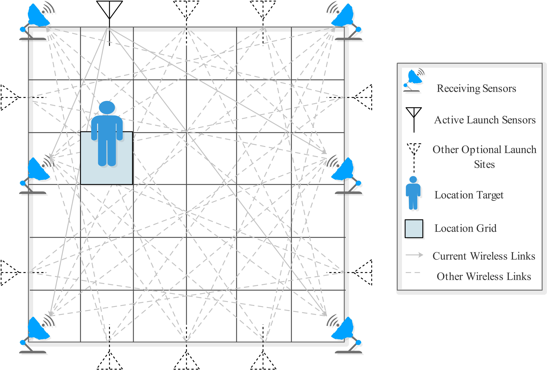


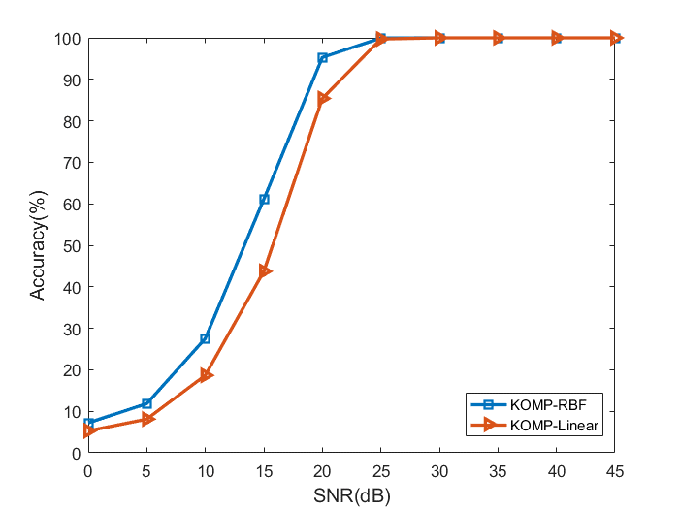
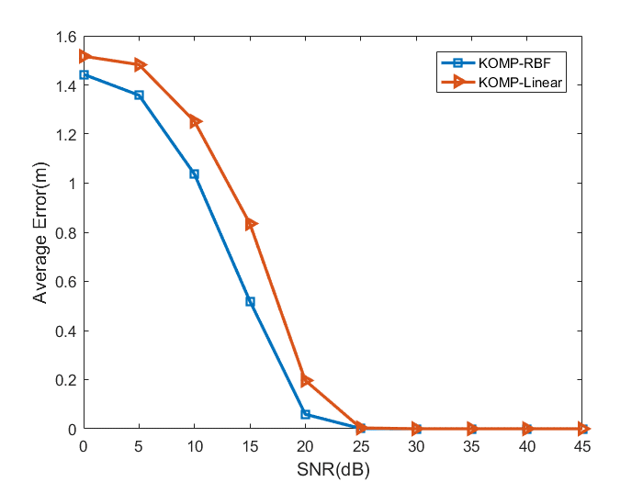
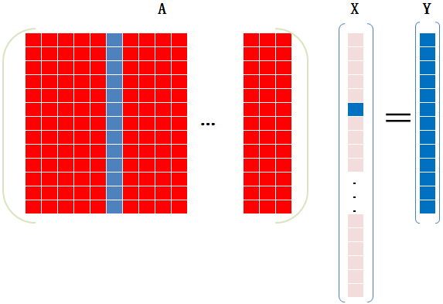
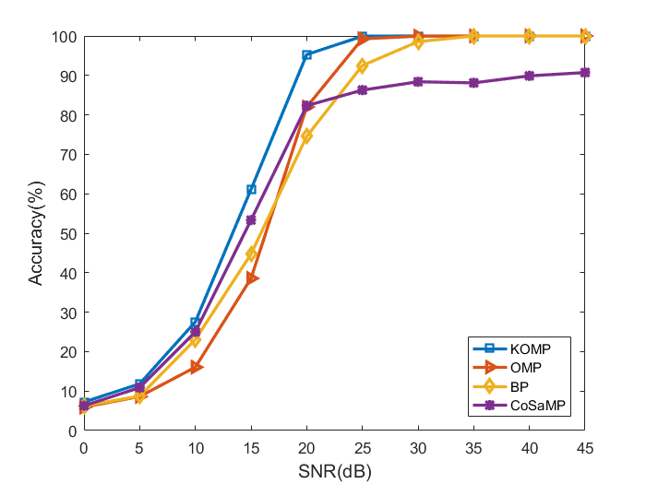
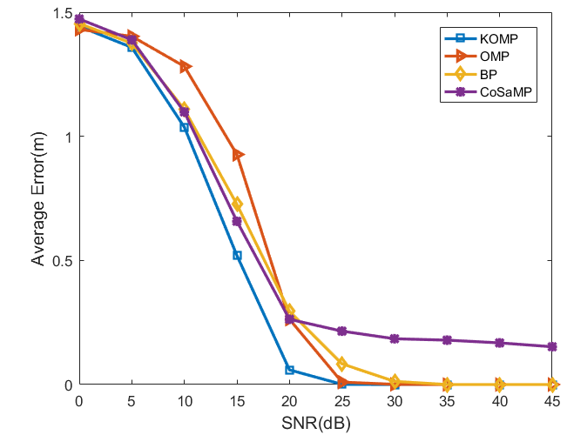

Device-Free Indoor Localization Based on Kernel Sparse Representation
Yuqi Jiang¹, Benying Tan¹, Shuxue Ding^{1 ,*}, Yujie Li¹, Xiaoju Chen¹
¹School of Artificial Intelligence, Guilin University of Electronic Technology, Guilin, China 541000
*Email: sding@guet.edu.cn
INTRODUCTION
features, we chose the RBF kernel in this work.
In some localization scenarios, the localization target does not necessarily carry a device that can transmit radio. As a result, device-free localization (DFL) has gained much attention in the field of localization research. Daily, we have radio wave signals passing through our body whether indoors or outdoors, which provides the basis for DFL. The masking and absorption of these radio waves by the target lead to different received radio waves at different locations. This allows for the localization to be viewed as a classification issue.
We regard DFL as a classification problem. Our proposed model is based on kernel sparse representation, which combines kernel function with sparse representation. The kernel sparse representation can be obtained by generalizing the sparse representation.
And we can obtain a new objective function after the kernel transformation.
kernel transformation
EXPERIMENTAL RESULTS
In this paper, we propose a new algorithm based on the kernel sparse representation (KSR) framework for DFL. The objective is to achieve higher accuracy and lower average localization error.
Localization performance of our proposed KOMP based on the RBF kernel and the linear kernel respectively in different noise environments. On the left: The proposed KOMP localization accuracy based on the RBF kernel and the linear kernel. On the right: Average error (AE) of localization for different kernel functions
MODEL AND FORMULATION
Sparse Representation Model：
Localization performance of the proposed KOMP and the compared algorithms in different noise environments, i.e., different SNR. On the left: Loclization accuracy of KOMP and other compared algorithms. On the right: Average error (AE) of localization for different algorithms.
$$Y=AX$$
Kernel Function:
CONCLUSION
The localization data has linearly indistinguishable data, so a nonlinear model is used to classify the test samples better. However, most of the nonlinear models increase the difficulty of solving the problem. We consider using the kernel function to convert the nonlinear problem into a linear one.
Since the number of localization data is larger than that of sample
We apply kernel functions with sparse representation for indoor localization. The kernel transformation improves the differentiability of the data.
We propose a kernel orthogonal matching pursuit (KOMP) algorithm with better noise resistance.

