Slide 1

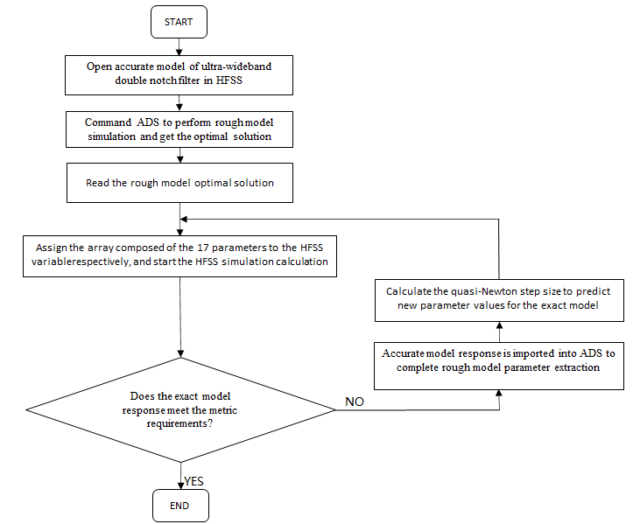
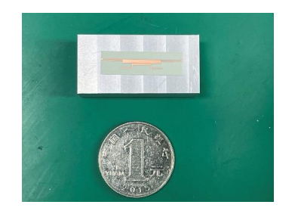
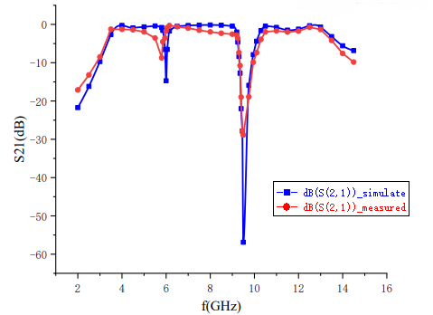
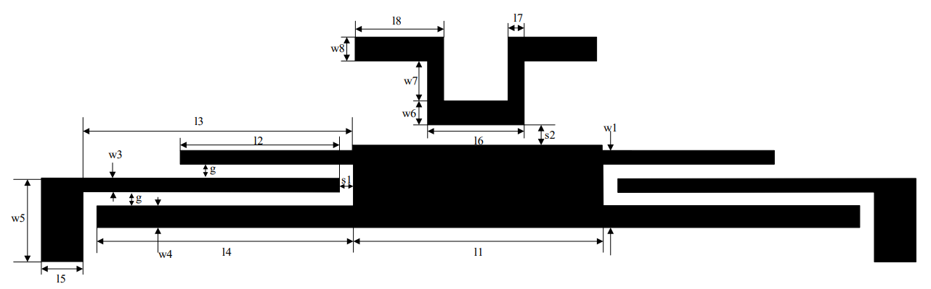

Design of Ultra-WideBand Dual Trap Filter Based on Active Space Mapping Algorithm
Wang Ximin, Chu Ran, Sun Linlin, Liao Jia
Nanjing University of Science and Technology
Abstract
In this paper, the Active Space Mapping algorithm is applied to an Ultra-WideBand dual trap filter with a relatively novel structure. Algorithms are implemented by using Matlab program assistance. The adaptive step iteration of the filter structure has more than a dozen variable parameter values. The optimal solution of the exact model is obtained only by the seventh iteration, thus it completed the fast and optimal design of the planar filter. Test results show that this filter has less than 2dB loss and less than 2.5dB flatness in the 4-12GHz band. Compared with the Initial Spatial Mapping algorithm, the Active Spatial Mapping algorithm no longer requires multi-point parameter extraction and a large number of simulations of the exact model, which largely saves time costs and computer resources, and has good practicality in engineering.
Algorithm flow chart
Processing and Testing
This paper proposes a fast implementation of ultra-wideband dual trap filter using Matlab to assist，the main program is shown in Figure below.
The final filter equipment physical dimensions are 24mm×15mm.The performance of the filter is tested by vector network analyzer, and the simulation results are compared with the measured results as shown below.
Simulation of the model
The model of the Ultra-WideBand double trap filter is built using ADS, and the selected Dielectric Substrate is Rogers RO4350 with a Dielectric Constant of 3.66 and a dielectric thickness of 0.254 mm. The main microstrip line (for the time being, the middlemost microstrip line to which the loading branch has been added is referred to as the main microstrip line) has dimensions l1, w1, branch lengths w3, l3 and w4, l4 on each side of the main microstrip line, with tap dimensions l5, w5 respectively. The first loaded branch structure added symmetrically is l4, w4; l6 to l8 and w6 to w8 are the dimensions of the type folded branches.
Conclusion
This paper designs an Ultra-Wideband Dual Trap filter based on an Active Space Mapping algorithm design. The software preparation details are realized by using the Matlab program-assisted algorithm, and the steps of the algorithm realization are shown in detail. A dozen variable parameter values ​​of the structure are iterated with adaptive step size, and the optimal solution of the accurate model is obtained only in the seventh iteration, which saves a lot of time. The footprint is also reduced by adding probing open branches, which can better help the filter to be miniaturised, easily planarised, integrated and physically promising for application in engineering experiments.

