Slide 1

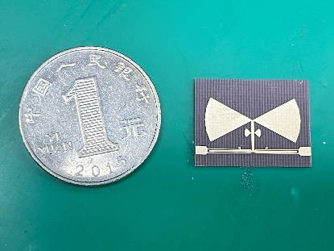
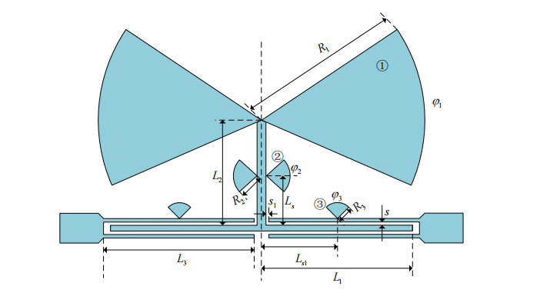

Design of Ultra-wideband Filter Based on Stub-Loaded Fan-stepped Impedance Resonator
Mao Ruili, Sun Linlin, Chu Ran, Liao Jia
Nanjing University of Science and Technology
Abstract
This paper adopts the form of the multimode resonator, and proposes a three-mode resonator that uses a new type of stub-loaded quarter-wavelength fan-stepped impedance resonator. This resonator has a symmetric structure, and its resonance characteristics can be analyzed by the odd-even mode analysis method, which can simplify the design process. And the characteristics of the fan-loaded two-finger coupling structure are analyzed, which can effectively improve the performance of the filter. The center frequency of the filter is 6.85GHz, the passband range is 3.1-10.6GHz, the in-band insertion loss is less than 2dB, the return loss is less than -20dB, and the out-of-band rejection is less than -40dB at 2GHz and 12GHz.
Analysis of the theory
Substance
In this paper, the form of stepped impedance loading branch multimode resonator is adopted, and the low impedance in the stepped impedance is changed to a fan shape. The resonator consists of a parallel coupling line and a quarter-wavelength fan-shaped stepped impedance branch, so that the filter has better stopband rejection and sideband selectivity. There are richer tuning parameters and a wider range of frequency regulation.
Ultra-wideband filter structure
Conclusion
In this paper, a fan-shaped SIR stub-loaded three-mode resonator structure is proposed over the conventional SIR structure.An ultra-wideband filter is designed by using this three-mode resonator. The filter achieves the ultra-wideband band range required by the FCC. Moreover, the filter has a small passband interpolation loss, good sideband steepness, and strong out-of-band rejection. The requirement of passband selectivity for ultra-wideband filters is satisfied.
The filter has a bandwidth of 3-10.6 GHz, a center frequency of 6.8 GHz, and a 3 dB relative bandwidth of 112%. The insertion loss of the filter is less than 0.17 dB and the return loss is less than -20 dB. The width of the blocking band can reach 16GHz, and the blocking band suppression is better than -30dB at 2GHz and 12GHz.

