Slide 1
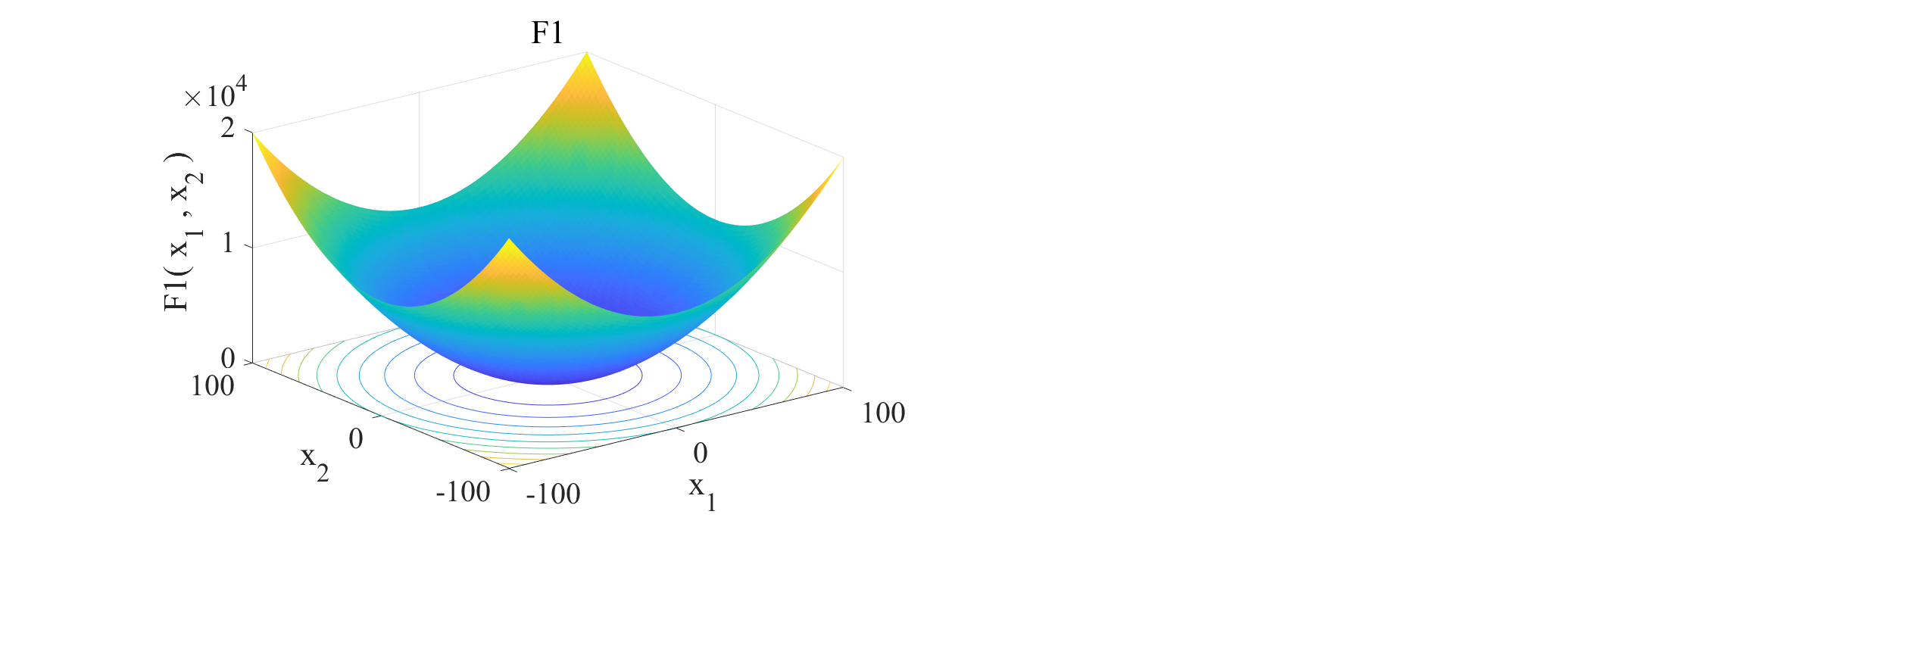
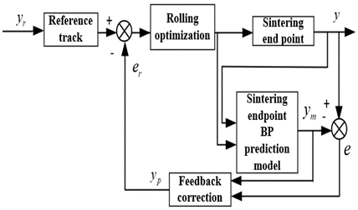
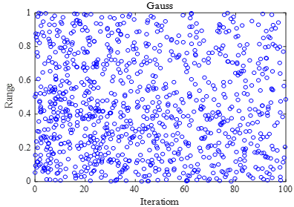
Data mining based IBBOA-BP sintering endpoint prediction model
Zongping LI¹, Jiang ZHU²,Lingzhi YI², Qiankun LIU² , Jianxiong HUANGNG²
¹Zhongye Changtian International Engineering Co., Ltd.
²College of Automation and Electronic Information of Xiangtan University, Xiangtan, Hunan, China
ABSTRACT
Performance Test
In the metallurgical industry, the sintering process is an important and indispensable part of iron making, which is an important means to produce sintered ore. And the stability or otherwise of the sintering endpoint is the key process that affects the quality and yield of sintered ore. In this paper, based on the method of BP neural network modeling, the sintering endpoint prediction model based on IBBOA-optimized BP neural network is proposed. In the IBBOA-BP neural network model, adaptive weights are introduced to coordinate the global and local search ability of BBOA; variation operators are added to improve the diversity of butterfly populations and avoid individual butterflies from falling into local optimum. The weights and thresholds of the BP neural network are optimized by IBBOA to avoid the problem of easy prematureness of the BP neural network and to improve the accuracy of the sintering endpoint prediction model
In this paper, a set of test functions are selected for performance testing to observe the effectiveness of the IBBOA algorithm. The original butterfly optimization algorithm BOA, particle swarm algorithm PSO are tested and compared to observe the experimental results. The test function independent variables x1 and x2 take values between -100 and 100, and the global optimal value of its objective function is 0. To ensure the computational efficiency, the population size of each algorithm is uniformly set to 30, and the number of iterations is 300, and its functional analytic formula is shown in Eq. The image of the function is shown in Fig.3.
SINTERING PROCESS FLOW
For the sintering endpoint prediction control, the BP neural network prediction control based on IBBOA algorithm is used. The process is as follows: for the nonlinear sintering endpoint system, IBBOA-BP is used to identify the model of the nonlinear BTP system, and the IBBOA-BP neural network prediction model of the sintering endpoint is established to predict the position of the controlled object BTP and then output the predicted value of the position y_m. The error e between the actual value of the BTP position and the predicted output value is calculated, and the error e is continuously reduced through the feedback correction link to make the predicted value closer to the actual value. The error e between the actual value of the BTP position and the predicted output value is calculated, and the error e is continuously reduced through a feedback correction process to make the predicted value closer to the actual value. In addition, the IBBOA algorithm is used as a rolling optimization strategy to solve the optimal control cart speed u(k) for the objective performance function J. The u(k) not only acts on the prediction model to adjust the prediction model, but also controls the sintering end point to stabilize the BTP at the set value. The structure of the sintering endpoint prediction control is shown in Fig.1.
Fig:3 Test function F1
Fig:4 Optimization process of test function F1 by IBBOA and other algorithms
The optimization results of BOA, PSO and IBOA for the test function are shown in Fig. 4. IBOA can accurately locate the optimal value within 30 iterations in the process of finding the optimal value of the test function F1. Compared with BOA and PSO algorithms, IBOA has faster convergence speed, higher convergence accuracy, and better global optimality finding ability.
Fig.1. Sintering end point prediction control structure diagram
EXPERIMENT AND ANALYSIS
IMPROVED BUTTERFLY OPTIMIZATION ALGORITHM
The BOA algorithm is an intelligent algorithm proposed by two scholars, Sankalap Arora and Satvir Singh. Individual butterflies are linked to each other by releasing and perceiving scent to form a social knowledge network. When a butterfly senses the scent released by a butterfly, it will search globally towards the source of the scent, and if it does not sense the scent, the butterfly will fly randomly and perform local search. algorithm. If the forward search does not improve the fitness of the algorithm or the value of the objective function, then the backward search is performed. The expression is :
Fig.5. Simulation results of different prediction models
TABLE I. FREIGHT TRAIN PARAMETERS
Models | RMSE | MAE | MAPE
BP | 2.0195 | 1.8643 | 8.3093%
PSO-BP | 1.5357 | 1.5034 | 6.698%
BOA-BP | 1.2664 | 1.2477 | 5.5618%
IBBOA-BP | 0.48174 | 0.44812 | 1.9966%
where,x is the position vector of butterfly individuals in the current iteration;f(x) is the fitness value of the current butterfly individuals;S is the step size.
The extended error system containing future information can be obtained from the hypothesis:In this paper, the chaotic mapping is introduced into the initialization stage of the population, using the Gauss mapping with regularity and randomness to make the initial solution more uniformly distributed in the solution space, and the mathematical expression of Gauss mapping is:
Fig.5. shows that the prediction model of sintering endpoint based on IBBOA-BP neural network has better prediction effect than the other three neural network prediction models, with higher accuracy and smaller error, and the predicted value of sintering endpoint position is also closer to the actual value. From the error results in Table 1, we can see that the errors of various performance indicators in the prediction results of the IBBOA-BP model are smaller than those of the other three models, and the errors of the PSO-BP model and the BOA-BP model are smaller than those of the single BP network model. This indicates that the IBBOA-BP model takes the advantages of the BOA algorithm and optimizes the weights and thresholds of the BP neural network, which makes its prediction accuracy and prediction error better than the other three models.
With Fig. 2. shows the scatter distribution generated by the chaotic mapping.
CONCLUSION
In this paper, the IBBOA algorithm performance is considered to design the method of IBBOA to optimize the weights and thresholds of BP neural network. The following conclusions are drawn：
The model has the highest prediction accuracy and the lowest error, which can be further promoted and applied in the actual sintering endpoint prediction
Since the conditions at the sintering site are more complex, there are certain constraints on the prediction of the sintering endpoint, so further research is needed on how the model handles the complex constraints.
Fig2: Gauss chaotic sequence distribution

