Slide 1
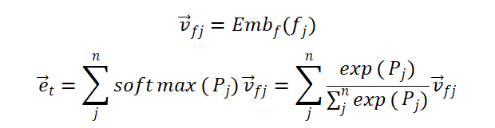
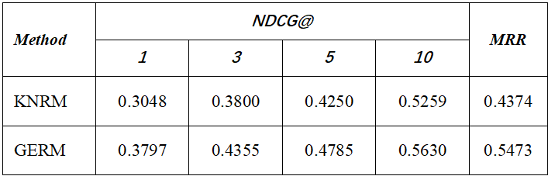
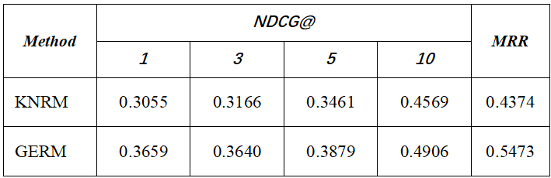
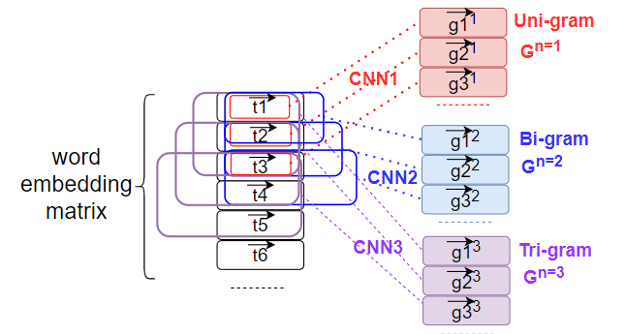
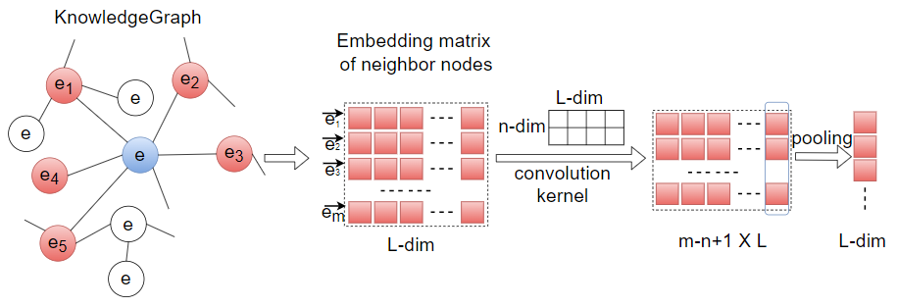


Knowledge Graph-Based Semantic Ranking for Efficient Semantic Query
Xuan Wang¹, Jianchao Lin¹, Chunhui Ren¹, Jinming Chen²
Email¹: {wangxuan, linjianchao, renchunhui}@geiri.sgcc.com.cn
Email²: cjm_nju@163.com
Abstract
The latent domain knowledge plays an important role in helping to improve efficacy of information search. In order to utilize and mine the latent semantic knowledge behind the query, we propose a knowledge graph-based semantic ranking method for efficient semantic query, where the keywords-based syntactical query is semantically enriched by mining out the latent semantic knowledge of keywords based on knowledge graph. The experiments were made over the related datasets against the traditional keywords-based method, and the results show that the method proposed in this paper can effectively improve the ranking performance.
Methods
A. N-gram word embedding.
We use Embedding as a layer of the model and use the word vectors trained by word2vec as the initialization weights, and then fine-tune it end-to-end. After that, we use convolutional neural networks on the word embedding matrix to fuse query words with information from different ranges of contexts, as shown in Fig.1.
3)Embedding of graph structure around entity
The graph structure around an entity in KG can effectively represent the semantic knowledge of the entity. GERM uses convolutional neural networks to fuse the embedding representations of the neighbor nodes around the entity into the entity embedding, as shown in Fig.2.
After the above three steps, we can get the embeddings of graph structure around entity, entity type and entity name, and finally combine the three embedding representations to generate the entity embedding by a linear layer.
Abstract
Methods
Table 1. DCTR-Test experimental results of KNRM and GERM
Table 1. TACM-Test experimental results of KNRM and GERM
The experimental results show that after the introduction of KG, the ranking effect of GERM has been significantly improved compared with KNRM, especially the ranking accuracy of the top-ranked documents has been improved significantly.
Fig.1 The N-gram embedding matrix
Fig.2 The embedding process of graph structure
Introduction
KG uses the graph structure to represent contextual semantics of an entity in the KG, so we fuse graph structure-based contextual information of an entity to represent the entity with enriched semantics. In this paper, we propose a neural network-based knowledge graph embedding model for semantic query ranking (GERM), which uses both word sequences and entity sets to represent queries and documents. Word embedding and entity embedding are crucial in this model.
B. Semantic entity embedding.
1)Embedding of entity name
The embedding representation of the entity name is learned by the embedding layer .
2)Embedding of entity type
Multimodal embedding combines auxiliary information with the KG to facilitate more effective semantic knowledge representations, for which we add entity category information. We use the soft attention mechanism to embed entity type.
Introduction
Conclusions
In this paper, we propose a neural network-based knowledge graph embedding model for semantic query ranking (GERM) where the keywords-based syntactical query is semantically enriched by the latent semantic knowledge of keywords based on knowledge graph. The results show the improvement in ranking accuracy of the model after applying KG and further illustrate the advantage of entities to enrich word-based ranking at the semantic level.
Conclusions
Result
Result
We used KNRM as the benchmark and designed three test scenarios for experiments, the results are shown in Table 1 and Table 2.

