Slide 1
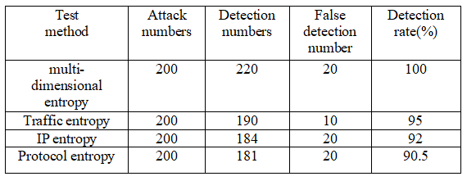


Research on DDoS attack detection based on multi-dimensional entropy
Yansen Zhou*, Qi Chen, Yumiao Wang
Department of Information Science and Technology, University of International Relations, Beijing, China
*Email: zhouys@uir.edu.cn
Abstract
DDoS attack detection in a single dimension cannot cope with complex and new attacks. Aiming at the problems existing in single dimension detection, this paper proposes an algorithm to detect DDoS Attacks Based on multi-dimensional entropy. Firstly, the algorithm selects multiple dimensions and establishes corresponding decision function for each dimension and calculates its information entropy. Secondly, the multi-dimensional sliding window CUSUM algorithm without parameters is used to synthesize the detection results of three dimensions to determine whether it is attacked by DDoS. Finally, the data set published by MIT Lincoln Laboratory is used for testing. Experimental results show that compared with single dimension detection algorithm, this method has good detection rate and low false alarm rate.
Methods
A. Traffic Dimensions
In case of DDoS attack, the attacker will send packets to the target host at an abnormally high rate for a period of time. The entropy maximization method is used to construct the membership function in fuzzy mathematics to measure the network traffic. Let the instantaneous traffic of the network at time t be L(T) and the overall average traffic be L_ avg(t)。
B. Packet Dimension
The average values of UDP packet number, the ratio of SYN request packets to TCP packets and ICMP packet number in unit time under normal network environment are counted in advance as threshold values.In the detection process, as long as a data value exceeds the preset threshold value, it will alarm once.If three alarms occur in a very short time, the algorithm will officially issue a DDoS attack warning.
C. IP Address And Port Dimensions
Under normal circumstances, the distribution of source I address and destination IP address is random, and the network service requested by users is relatively single. However, when DDoS attacks occur, a large number of source IP addresses and a certain number of target ports will be generated randomly, while the destination IP addresses are relatively concentrated. The ratio of source IP address to target IP, source IP address to target port and target port to destination IP address increases significantly.
D. Multi-dimensional Entropy Detection
In the process of multi-dimensional entropy detection, judge whether it is a large traffic through the threshold, then detect the packet dimension, whether to send a DDoS attack alarm, and finally observe the change of IP relative entropy. The probability and attack level of DDoS attack can be obtained through the detection of multi-dimensional entropy.
Results
Performance Indicators of Test Set
The three dimensions show that the multi-dimensional entropy DDoS attack detection method proposed in this paper can not only detect DDoS attacks accurately, but also judge the DDoS attack level, and the detection rate is better than that of single dimension DDoS attack detection parties.
Table.1 Comparison experiment results
Conclusions
Based on the one-dimensional DDoS attack detection model, this paper proposes a DDoS attack detection algorithm combined with multi-dimensional information entropy. The three-dimensional entropy in normal traffic is analyzed, and the threshold to distinguish normal traffic from abnormal traffic is determined. The sliding window multi-dimensional nonparametric CUSUM algorithm is used to synthesize the three-dimensional detection results to determine whether DDoS is attacked by DDoS. DDoS attack levels are divided into different levels.
Fig.1 Mebership function
Introduction
Firstly, the limitations of a DDoS attack detection model based on network characteristics are analyzed. This paper proposes an algorithm to detect DDoS attacks by combining multi-dimensional entropy. This method selects three network characteristics, namely network traffic, IP address distribution and packet protocol, and establishes a good decision function for each dimension to calculate its information entropy.
Table.1 Attack level and distribution
Acknowledgment
The paper is supported by Special scientific research project of national security advanced discipline construction of School of international relations.
2020 IEEE 8th International Conference on Computer Science and Network Technology (ICCSNT)

